Slide 1


Pick ‘n Pay Retail Sales: Revenue Optimization
By Siyabonga Mofokeng
22 April 2026
*The use of the franchise name Pick ‘n Pay is only for project completion and not a direct representative of sales performance

Slide 2
Index:
1. Executive Summary
2. Introduction
3. Methodology
4. Results
5.Dashboard
6. Discussion
7.Conclusion

Slide 3
1.Executive Summary
Pick ‘n Pay, which is a South African retail franchise focused on family-friendly products. They have supplied us with the annual gross product category income for the year 2023. I have been tasked to analyse the performance of product categories.
I’ll be digging deep into :
- Annual product performance
- Gender revenue contribution
- Product Quantity by Day of the Week
- Customer Demographic Analysis

Slide 4
2.Introduction
Purpose
This report was compiled to analyse product category performance for Pick ‘n Pay, which focuses on selling clothing, beauty, and electronic products to its customers. I desired to find out which product categories are underperforming and how we can increase revenue.
Target point
The inconsistent product performance for Pick ‘n Pay
Value of the analyst
This report will inform retail store managers at Pick ’n Pay about the potential ways to increase revenue and stop all negative forces hindering revenue.

Slide 5
3. Methodology
Data Collection: Kaggle, Retail Sales Dataset by Mohammad Talib
Tools Used: Microsoft Excel (Data Manipulation), IBM Cognos Analytics(Exploratory Data Analysis & Data Visualization)
Process:
- Transformation: Converting the dataset from its comma-separated format to a tabular structured format. Converting Date from numerical to Days of the Week (dddd)
- Cleaning: Removing duplicates from the entire dataset
- Analysis: Separating and creating key column combinations to answer important questions. Used visuals to gain further and additional insights

Slide 6
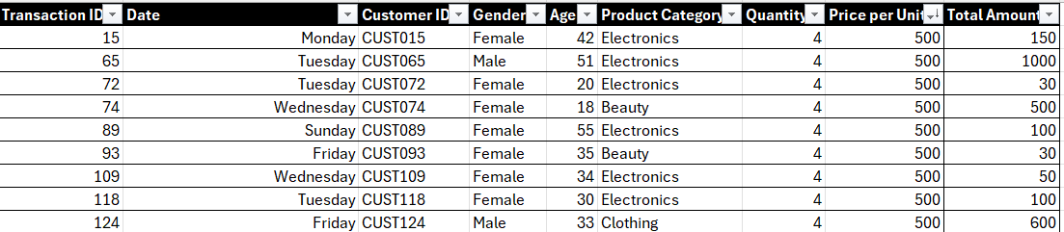
4. Results
🔹 Importance of Results (Insights)
1. Drive decisions Results turn raw data into answers like:
2. Show business value Good results connect analysis to outcomes:
3. Provide clarity They simplify complex data into clear takeaways that stakeholders can act on.
4. Support strategy Results help teams plan next steps instead of guessing.

Slide 7
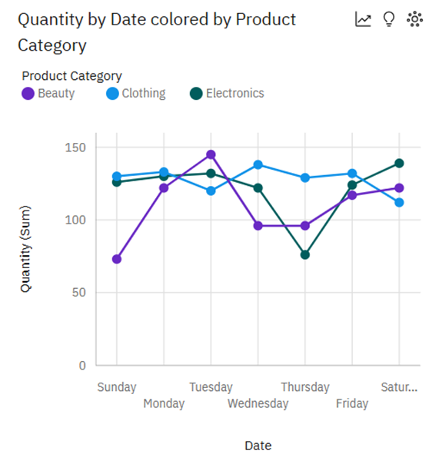
Product Performance:
1. Which product category sold more units throughout the entire year?
A- Clothing is the most sold product throughout the year 2023, with 894 units sold, and the peak combined number of units sold for the week for clothing is on Wednesdays at 138 units sold.
2. What may have caused the product category mentioned above to sell more than other categories?
A- Clothing sells out more due to :
High Demand: High demand due to their versatility and adaptability
Sustainability:
Consumers are increasingly looking for sustainable and eco-friendly clothing options
3. Influencer marketing:
Influencers play a significant role in shaping fashion trends and preferences
4. Fast Fashion:
This industry offers quick and affordable clothing options

Slide 8
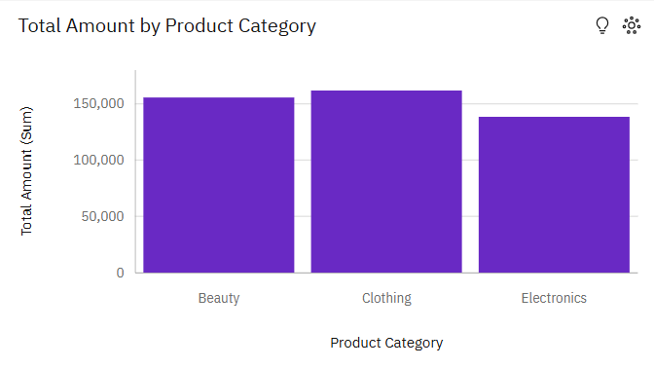
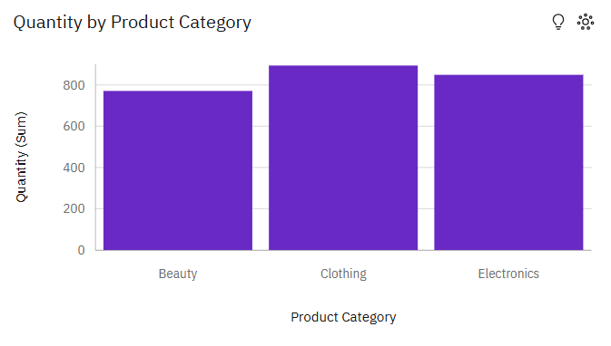
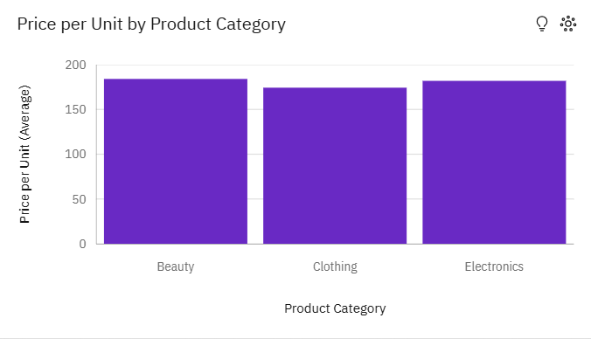
1. Which product generated the most revenue in 2023?
Clothing generated the most revenue with R161,865, which is more than electronics with R138,480 and beauty products at R153,655.
2. Which product category has the highest total unit quantity sold?
Clothing sold more units with 894, whilst electronics and beauty products sold 849 and 771 units respectively.
3. What are the average prices per unit for each product category?
3.1 Beauty – R184.00
3.2 Electronics – R181.9
3.3 Clothing – R174.29

Slide 9
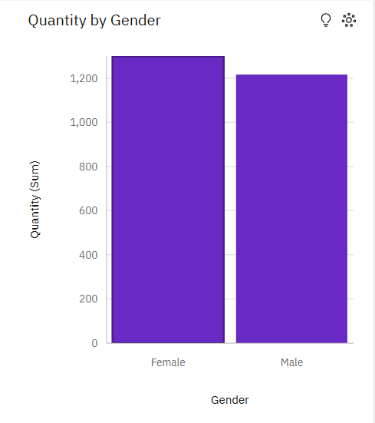
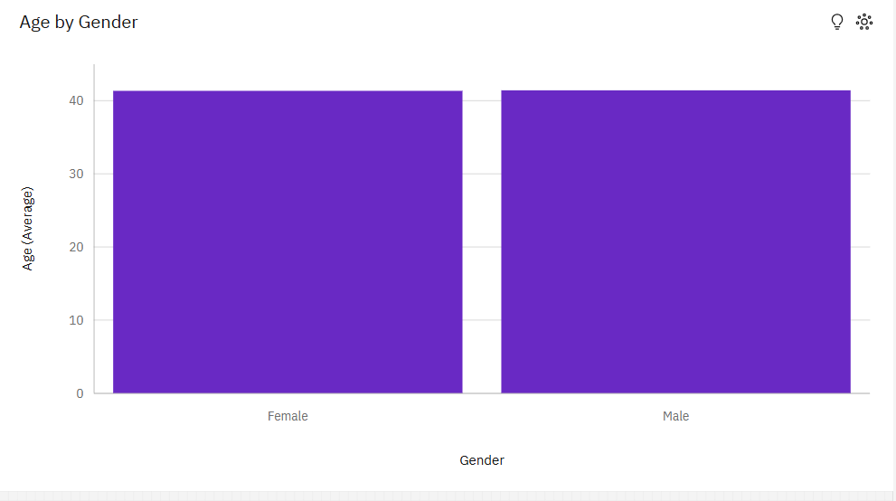
Gender Contribution:
Which gender appears more frequently in the dataset?
A- Females appear more frequently with a total product sales quantity of 1,298, whilst males appeared 1,219. This means that females are the gender that made the most purchases in this store during 2023.
What are the average ages per gender purchasing from the store?
A- The average age of male customers stands at 41,43 years old, whilst females have an average age of 41,36 years old. In conclusion, the average age of customers at this store is approximately 41 years.

Slide 10

5. Dashboard
🔹 Importance of Dashboards
1. Visual understanding Dashboards make patterns obvious using charts instead of raw numbers.
2. Real-time monitoring Track performance continuously (sales, users, trends).
3. Faster decisions People can quickly see what’s happening without reading long reports.
4. Interactivity Users can filter and explore data themselves. (available on pdf)

Slide 11
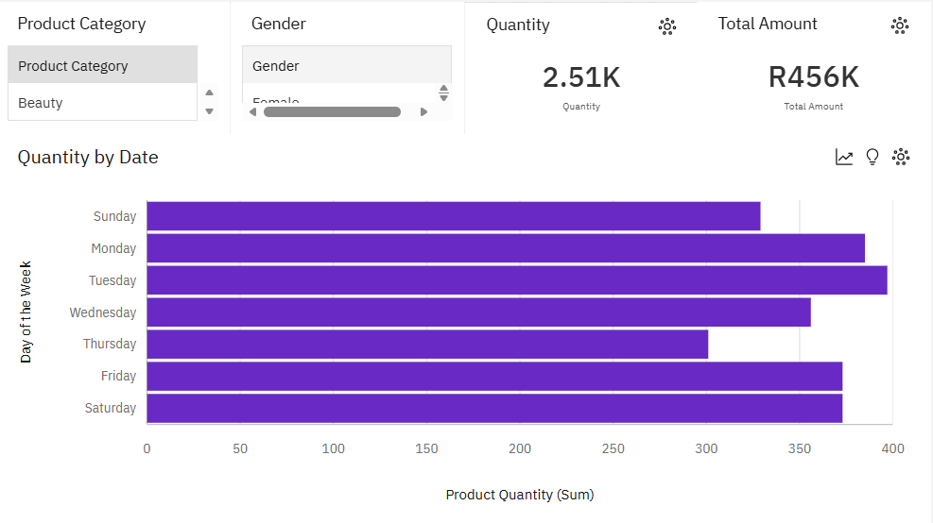
Product Quantity by Day of the Week during the year 2023
*All dashboards are available in the attached PDF

Slide 12
What day of the week has the highest total product quantity sold in 2023?
Tuesday is the day of the week that generated the highest units sold, with 397 units throughout the year.
What day of the week has the lowest demand?
Thursday is the day of the week that generated the lowest units sold, with only 301 units through the year.
How does product demand vary by days of the week in 2023?
Demand through the week is not constant. Demand fluctuates through the week. Sales initially start off at 329 units on Sundays, then encounter an uphill climb towards their first and highest peak on Tuesday with 397 units sold. Sales then drop from Tuesday to Thursday to a total of 301 units sold. Then the quantity increased by 24% towards Friday and Saturday, see the total sales increase and remain at a constant value of 373 units, respectively.
Key Takeaways:
Sales weaken at the beginning of every week and towards the end of business weeks

Slide 13
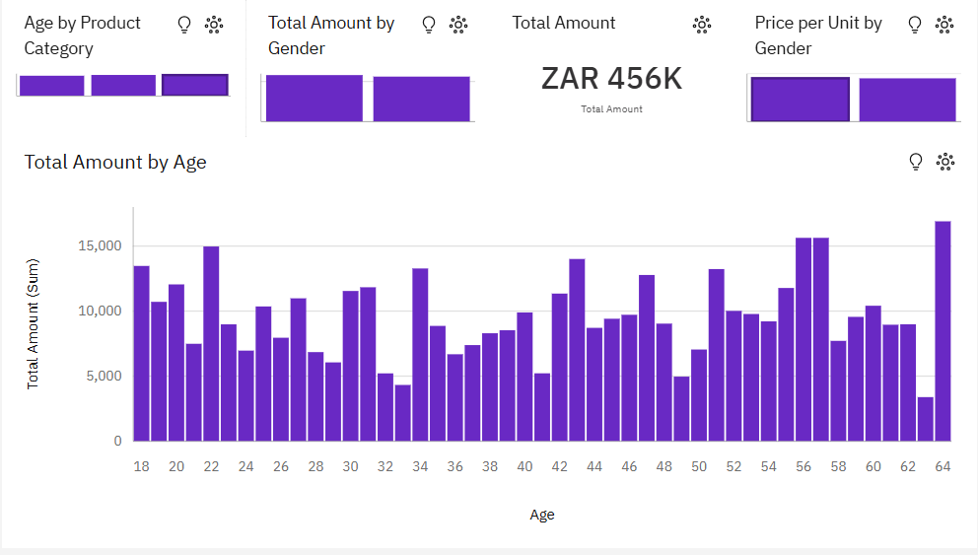
Customer Demographic Analysis

Slide 14
What are the average ages of customers per product category?
The average ages for each product are as follows:
Beauty – 40,37 years old
Clothing – 41,95 years old
Electronics – 41,74 years old
Which gender contributes most to the total revenue of 2023?
Females contributed more to the total revenue earned with R231,785, whilst males contributed R224,215.
What are the average prices per unit for each gender?
Females contribute an average price per unit value of R180.07, and males contribute R179.7.
Which age group generated the most revenue for Pick ‘n Pay in the 2023 calendar year?
Out of all the age groups, 64-year-olds generated the most revenue out of all the other groups, with an amount of R16,900

Slide 15

6. Discussion
Now what do these findings tell us? That’s what we need to find out.
We will be discussing the following :
Sales inconsistency
Gender and Age inconsistency

Slide 16
Sales inconsistency
Sales seem to remain constant during weekends and enter a period of fluctuation during the weekdays.
Availability of customers reduces during weekdays because of work and school days. This also explains why 64-year-olds were the highest contributors to Pick ‘n Pay’s annual gross earnings. The elderly are typically in their retirement stages, which allows them more time to travel to stores, unlike the youth and adults.
The relationship between customer availability and sales quantity shares an expected relationship. As one variable increases, the other will also increase.
So, Pick ‘n Pay is limited to consistent profits during the weekend. During the weekdays, there are uncertainties in product performance.

Slide 17
Gender and Age Inconsistency
The gender of customers does not have a significant effect on revenue, as females slightly contribute more than males in the annual gross earnings of Pick ‘n Pay for the year 2023. As we drive deeper, we realise that the difference in ages is the major imbalance in the earnings of Pick ‘n Pay.
Ages between 24 and 54 showcase a lack of desire in purchasing from the store, which limits the amount of possible revenue Pick ‘n Pay could have generated.
The relationship between the customers aged 24-54 and customer availability showcases a clear result, which can be referenced in the dashboard (Customer Demographic Analysis). This relationship shows that ages 24-54 contribute less to the annual gross earnings. This age group is known to be in their productive years, which decreases their availability.

Slide 18
7. Conclusion
Main Findings :
- The most purchased product category was clothing
- 64-year-olds are the main contributors to the annual gross earnings of Pick’n Pay
- Customer availability directly affects gross annual earnings
Answer to Problem:
The causes of the inconsistent sales performance in Pick ‘n Pay are :
Customer availability affects the increase in potential revenue.
Product performance remains inconsistent through the entire work week.
Pick ‘n Pay has failed to optimize its trade strategies, which causes it to put equal effort on both highly and low-productive business days

Slide 19
Recommendations
Organize more promotions during the weekends and short periods after customer pay days, to maximise the potential trade flow.
Increase the amount of stock/inventory during planned promotion days; this ensures that there will be no possibility of stock running out, which will halt proceedings.
Reduce the number of allocated staff working during weekdays to save more money due to lower customer activity.
Invest in influencers, who will promote products to the youth ( as the youth are known to use social media more than other age groups). This pulls in more young customers to the store, leading to more profits.

Slide 20
“Success is not final; failure is not fatal: it is the courage to continue that counts.”
- Winston Churchill

